Slide 1
AI Tools for Web and App Development
(أدوات الذكاء الاصطناعي لتطوير الويب والتطبيقات)

Slide 2
outline
The AI-Powered Revolution in Development (الثورة المدعومة بالذكاء الاصطناعي في التطوير)
Visual Web Development (تطوير الويب المرئي)
AI-Powered Website Design (تصميم المواقع المدعوم بالذكاء الاصطناعي)
Intelligent Automation Workflows (سير عمل الأتمتة الذكية)
Backend as a Service (الخلفية كخدمة)
AI Chatbot Builder (منشئ روبوتات الدردشة بالذكاء الاصطناعي)
Project Management Reinvented (إعادة ابتكار إدارة المشاريع)
AI-Driven Design Collaboration (التعاون في التصميم المدفوع بالذكاء الاصطناعي)
Lightweight Web Automation (أتمتة الويب الخفيفة)
Unified Data Integration (تكامل البيانات الموحد)
AI-Powered Workflow Automation (أتمتة سير العمل المدعومة بالذكاء الاصطناعي)

Slide 3
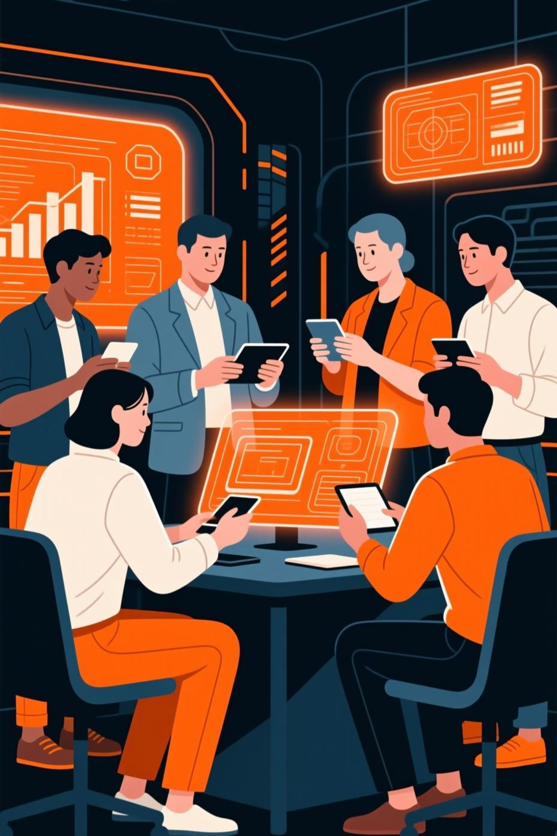
The AI-Powered Revolution in Development
Artificial Intelligence is transforming how we build, automate, and innovate. This presentation explores cutting-edge AI tools that empower developers and non-developers alike, fostering unprecedented levels of productivity and creativity.
No-Code Development
1
Build applications without writing extensive code.
Intelligent Automation
2
Streamline workflows and repetitive tasks.
Enhanced Productivity
3
Boost efficiency across various domains.
Innovative Design
4
Leverage AI for creative and functional design solutions.

Slide 4
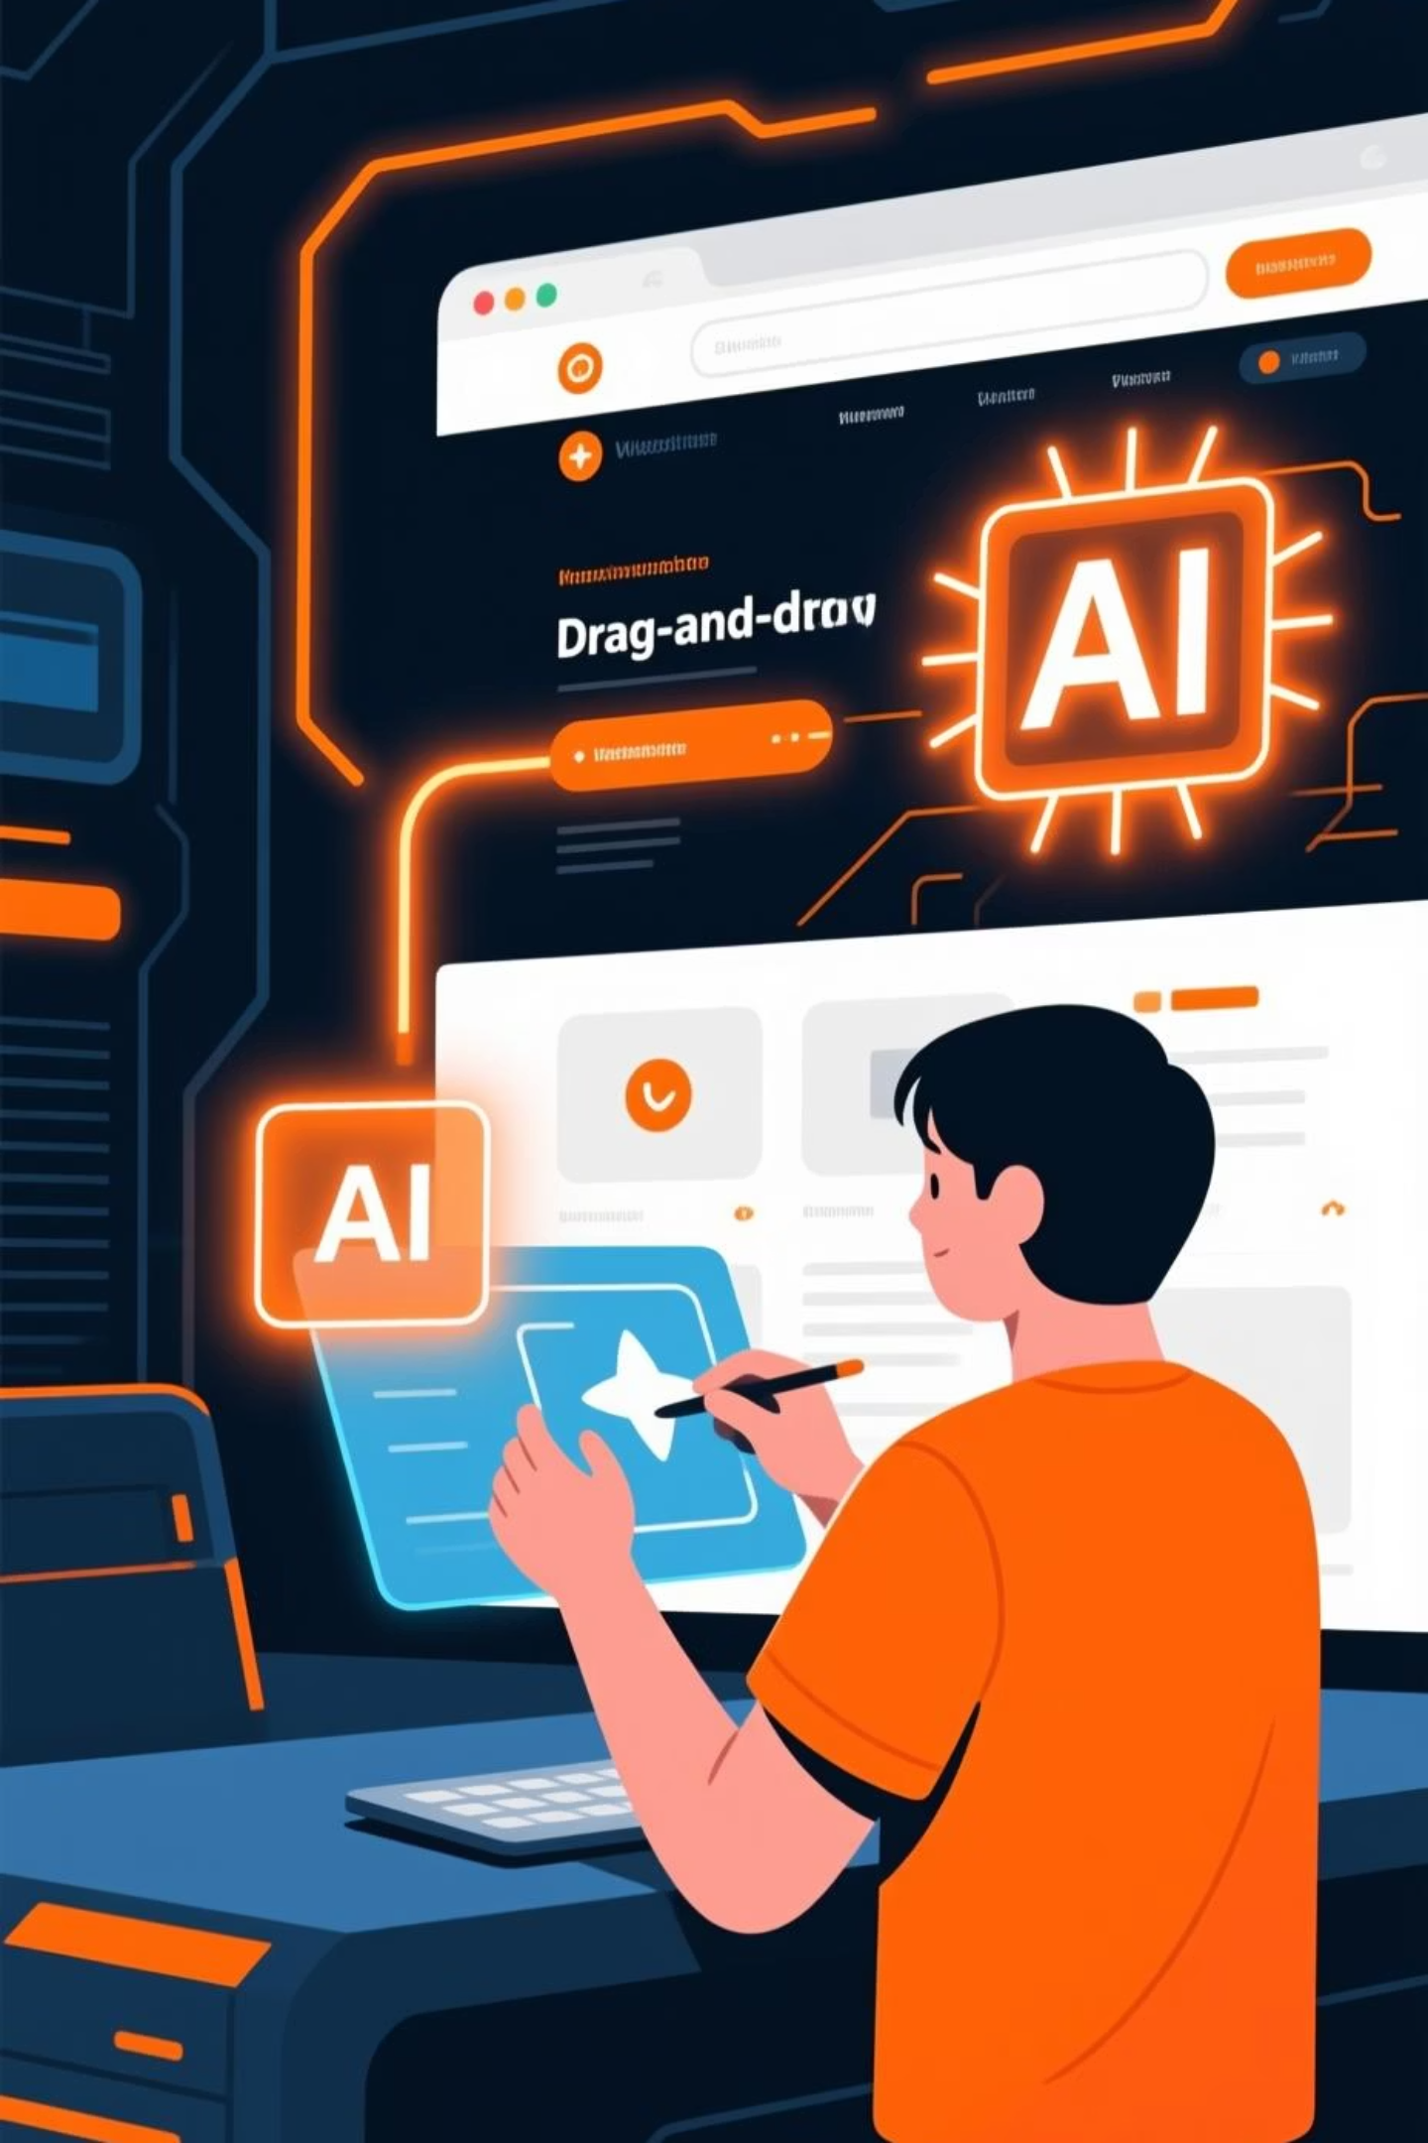
Bubble AI: Visual Web Development
Bubble AI is a powerful no-code platform that allows users to build web applications without writing any code. It integrates AI capabilities to enhance development, offering visual programming and extensive customization. bubble.io
Steps to Use:
Practical Example:
Drag-and-drop elements onto your canvas.
Build a customer relationship management (CRM) tool to track client interactions, manage leads, and automate follow-up emails, all tailored to your business needs without a single line of code.
Define workflows for user interactions.
Connect to databases and external services.
Deploy your custom web application.

Slide 5
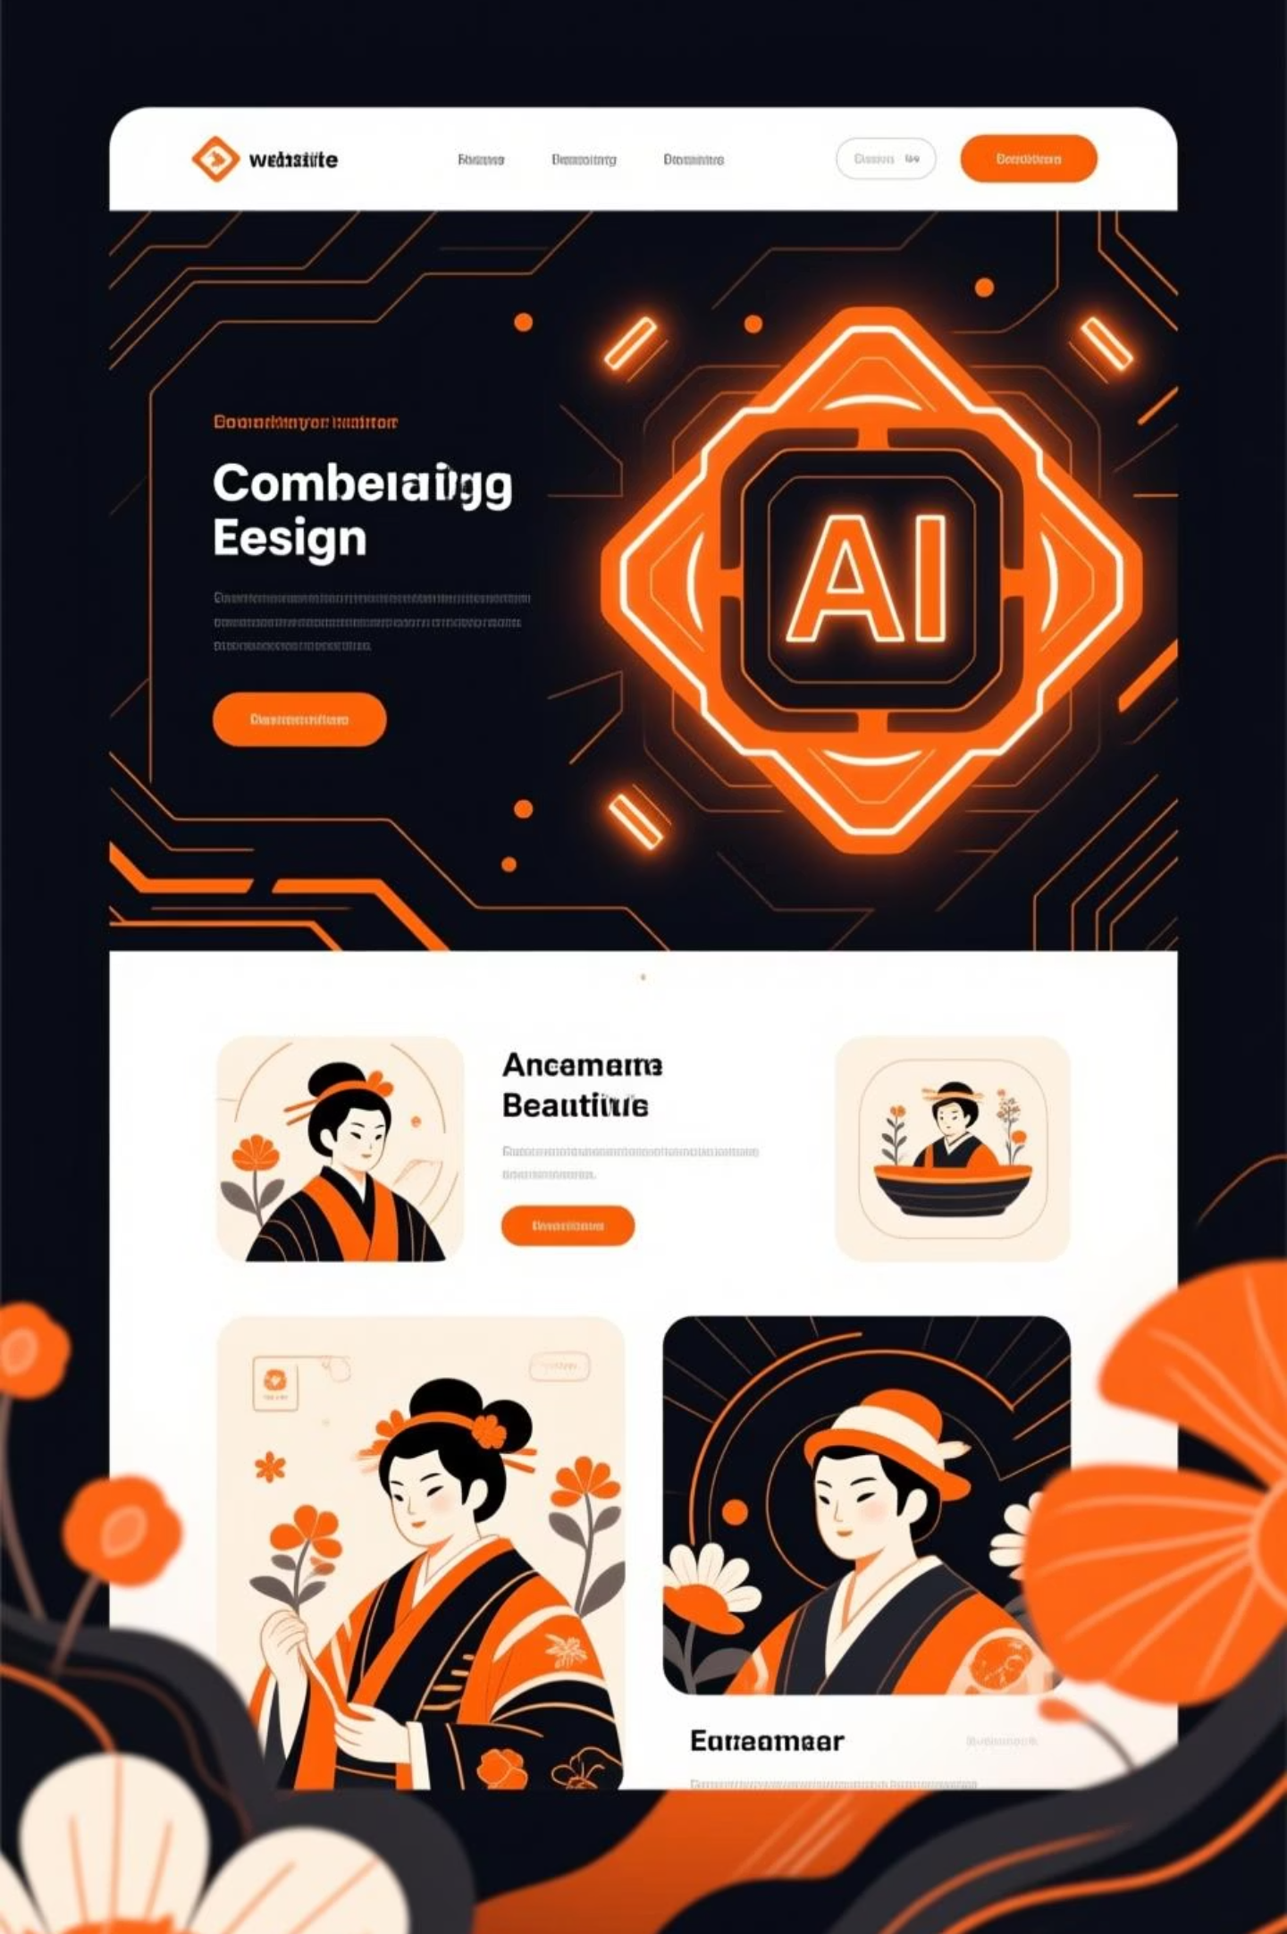
DeepSite: AI-Powered Website Design
DeepSite.ai leverages AI to generate and optimize website designs, focusing on user experience and conversion. It helps create visually appealing and functional websites with minimal effort. deepsite.ai
Input Requirements
Provide basic information about your project and goals.
AI Generation
AI generates initial design concepts and layouts.
Refine & Customize
Tweak designs, adjust elements, and add content.
Publish Your Site
Launch your AI-designed, optimized website.

Slide 6
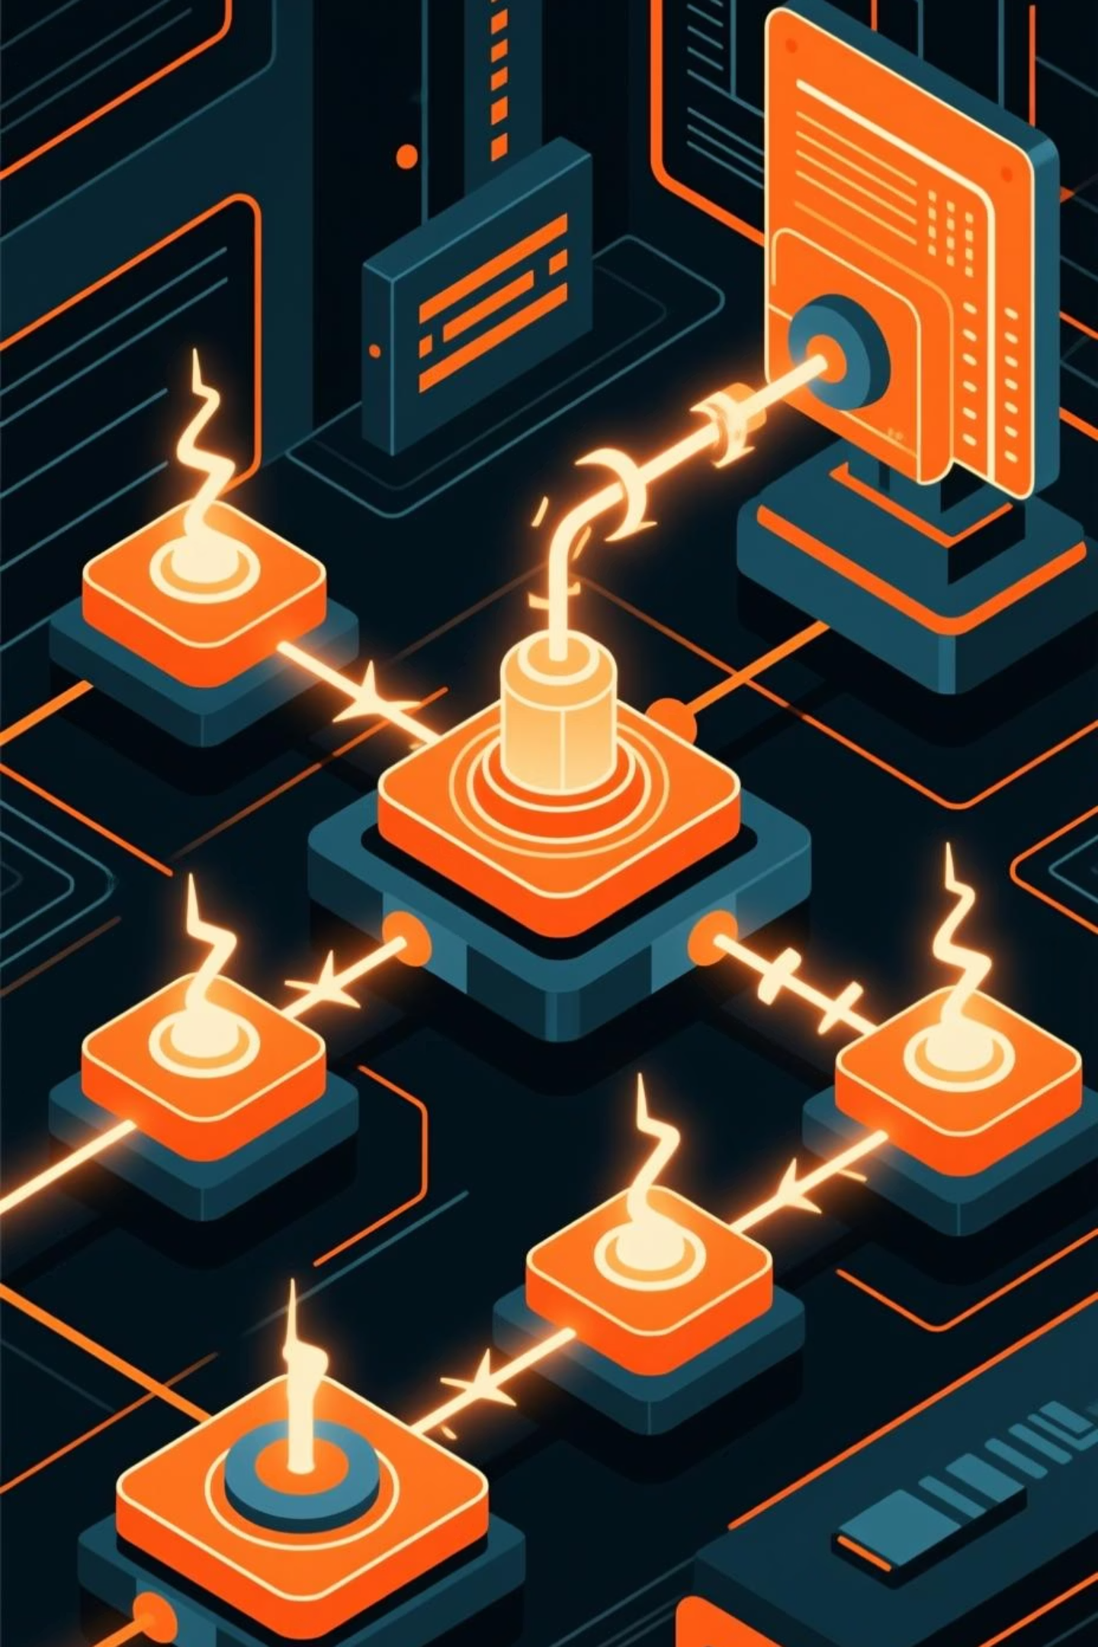
Rork.app: Intelligent Automation Workflows
Rork.app is an AI-driven platform for automating complex workflows and business processes. It helps organizations achieve greater efficiency by connecting various tools and systems. rork.app
Steps to Use:
Practical Example:
Define your process steps and desired outcomes.
Automate your customer onboarding process, from initial sign-up and welcome emails to data synchronization across your CRM and marketing platforms.
Integrate your existing apps and services.
Build automation flows using a visual editor.
Monitor and optimize performance.

Slide 7
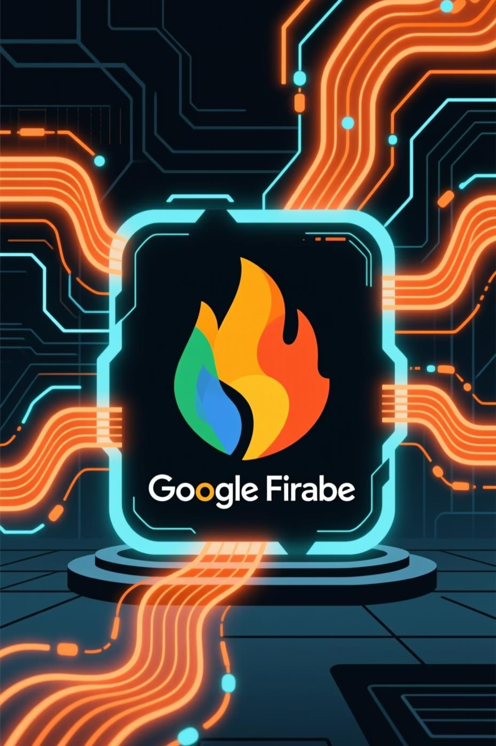
Firebase Studio: Backend as a Service
Firebase Studio by Google provides a comprehensive suite of tools for app development, including databases, authentication, hosting, and analytics. It accelerates development by offering ready-to-use backend services. firebase.google.com
1
2
Setup Project
Choose Services
Create a new Firebase project in the console.
Select services like Firestore, Authentication, Hosting.
3
Integrate & Deploy
Connect your front-end and deploy your application.

Slide 8

TARS: AI Chatbot Builder
TARS allows users to build intelligent chatbots without coding, enabling automated conversations for customer support, lead generation, and interactive forms. hellotars.com
Steps to Use:
Practical Example:
Design conversation flows and logic.
Create an FAQ chatbot for your university's admissions page to answer common prospective student questions 24/7.
Add question types and responses.
Train your chatbot with relevant data.
Embed the chatbot on your website or platform.

Slide 9
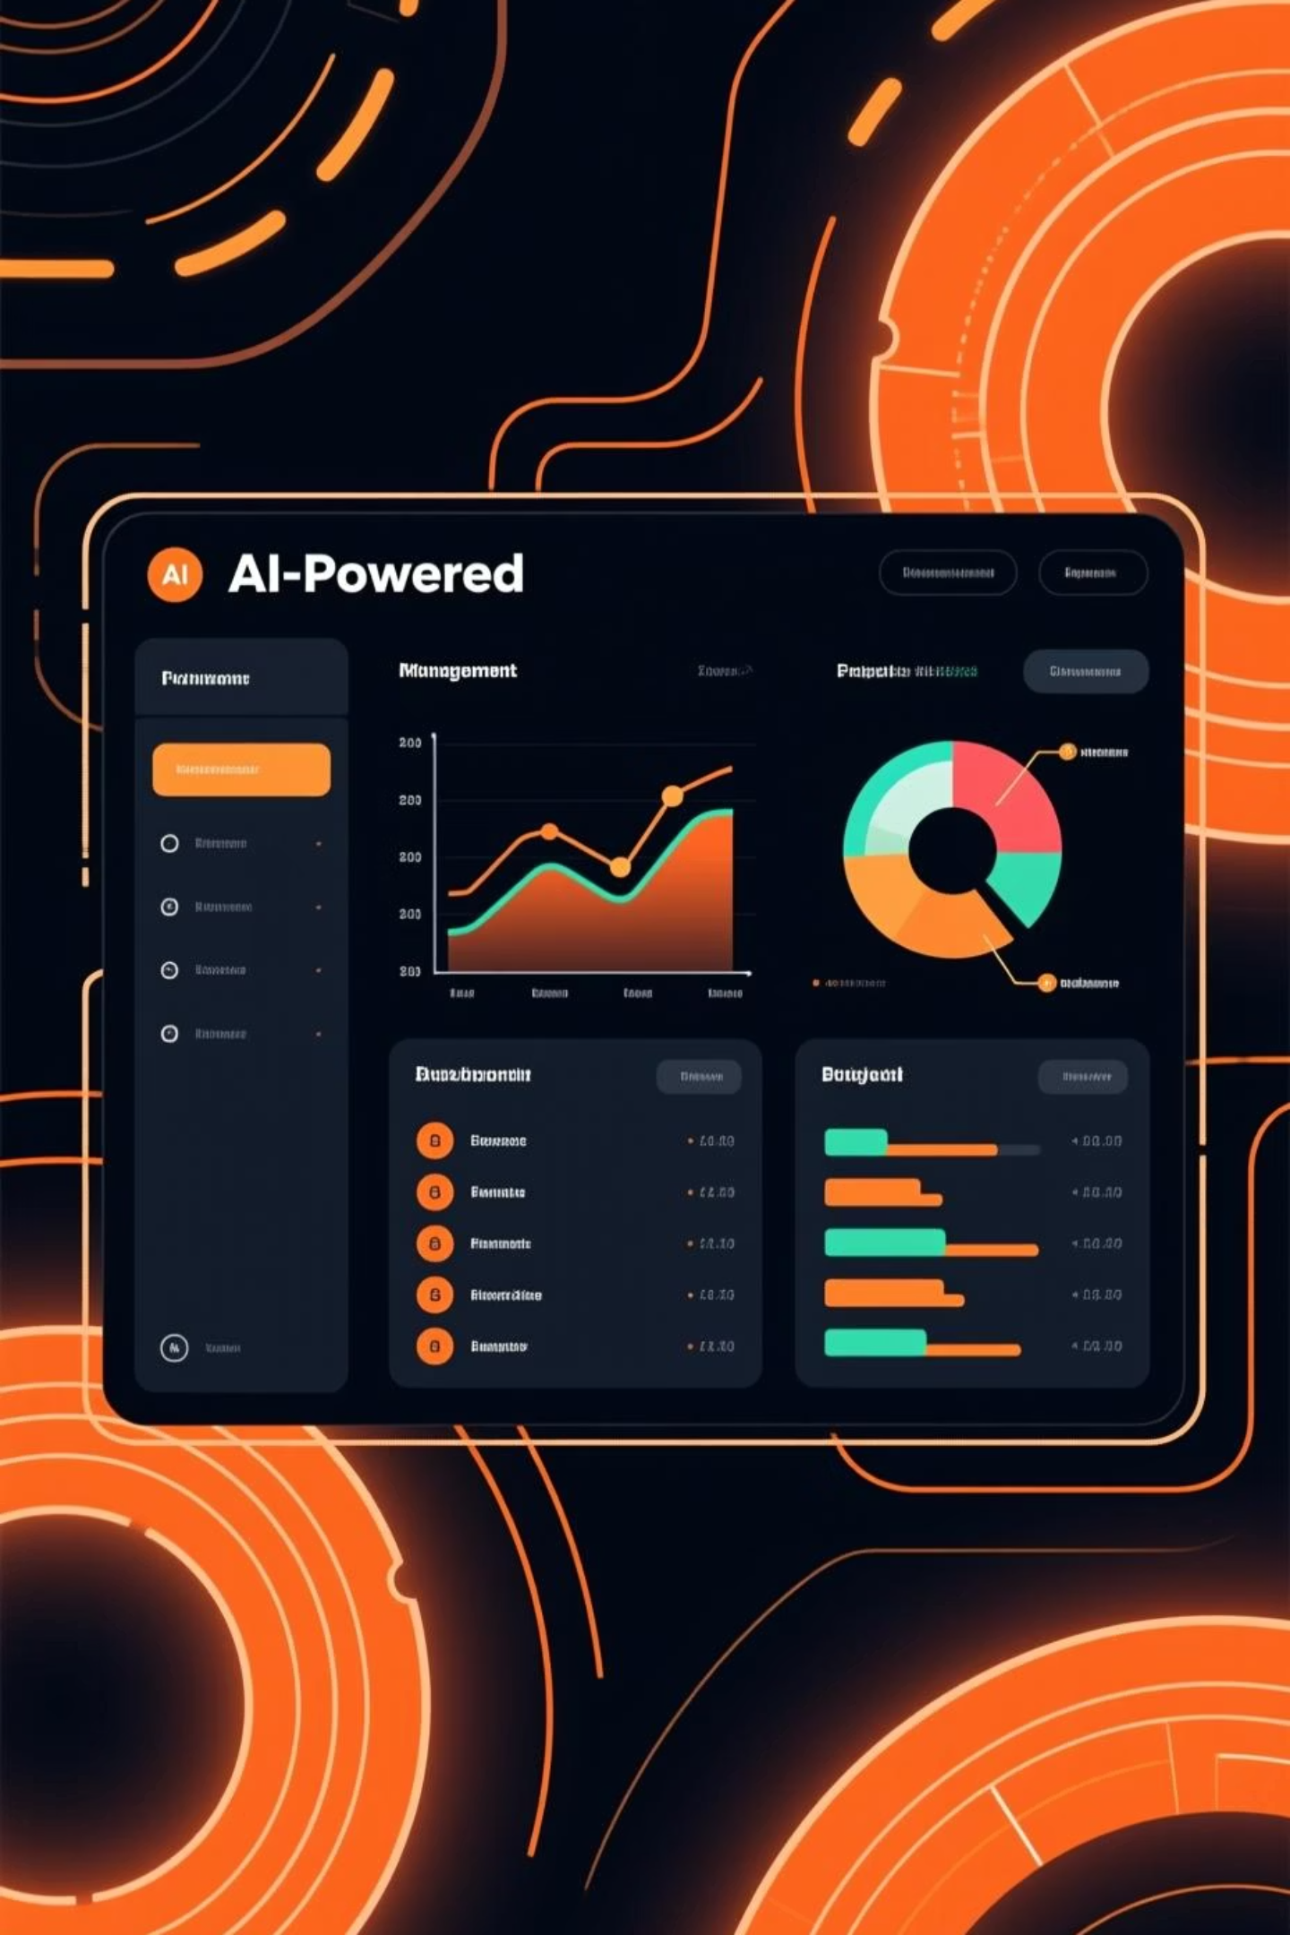




PMFM.ai: Project Management Reinvented
PMFM.ai offers AI-powered project management features, helping teams plan, track, and execute projects more effectively through intelligent insights and automation. pmfm.ai
Define Project
Outline goals, tasks, and team members.
AI Planning
Receive AI-driven task breakdowns and timelines.
Monitor Progress
Track tasks, identify bottlenecks, and get smart alerts.
Optimize & Adapt
AI suggests adjustments for better outcomes.

Slide 10
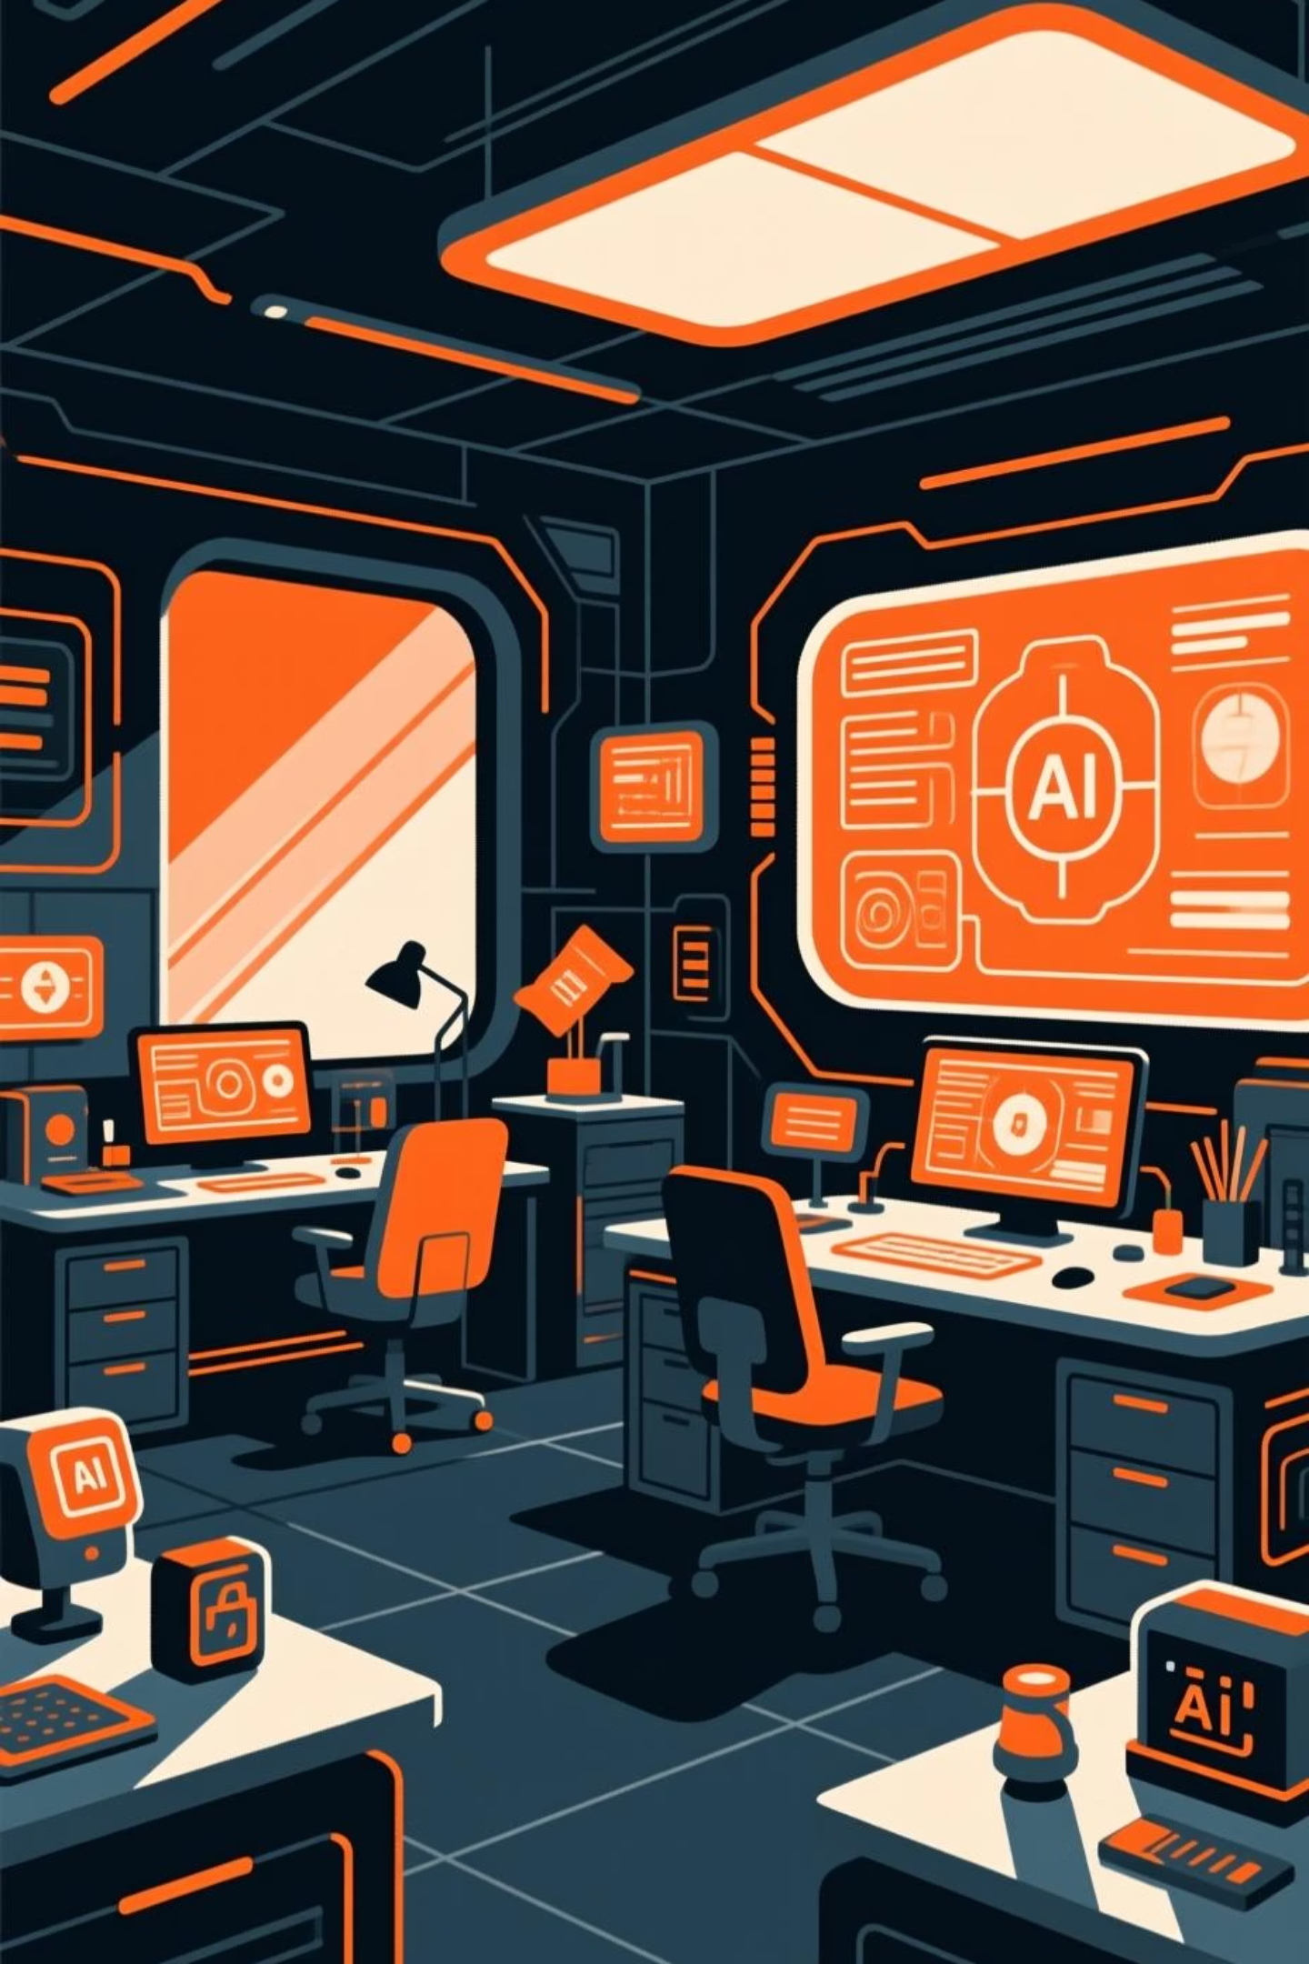
Stitch: AI-Driven Design Collaboration
Stitch.design is an AI-powered design platform that facilitates collaboration and accelerates the design process, from ideation to final execution. It integrates AI to suggest elements, optimize layouts, and maintain brand consistency. stitch.design
Steps to Use:
Practical Example:
Import design assets and brand guidelines.
Rapidly prototype and iterate on marketing campaign visuals, ensuring all designs align with brand standards and resonate with the target audience.
Utilize AI suggestions for design elements.
Collaborate with team members in real-time.
Export designs in various formats.

Slide 11
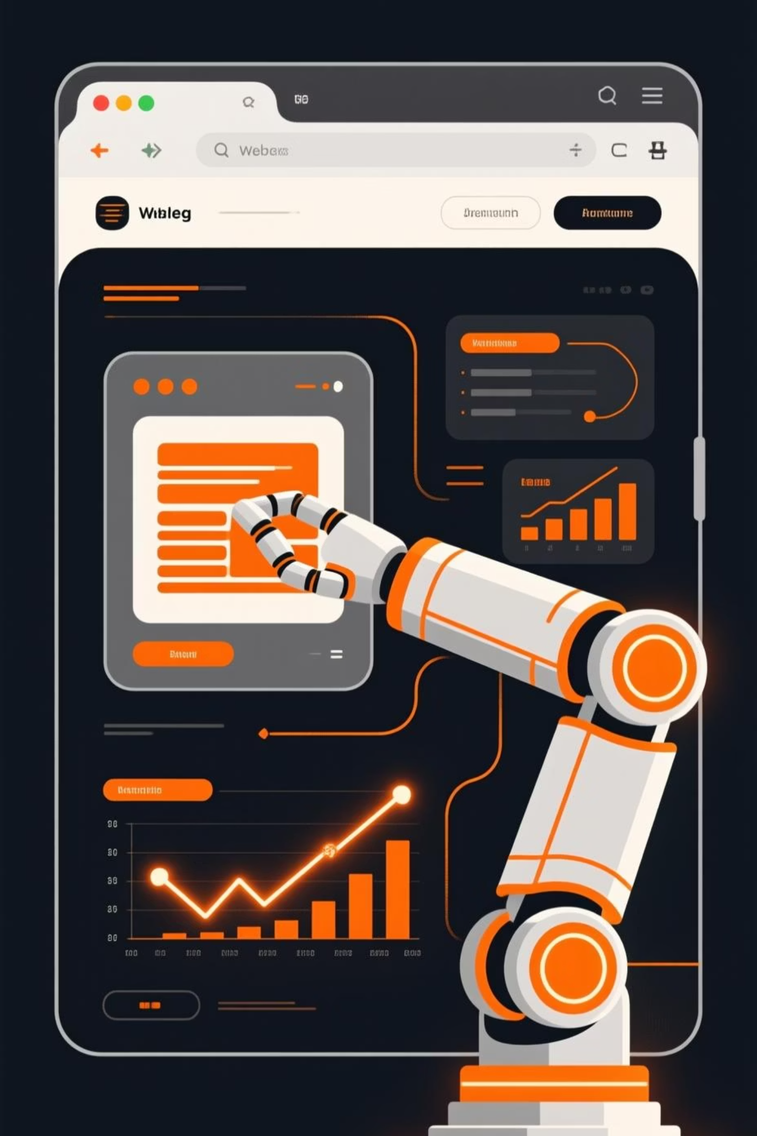
Nano Browser: Lightweight Web Automation
Nano Browser is an ultra-lightweight web browser designed for efficient and scriptable automation. It allows developers to create fast, headless browser automation scripts without the overhead of a full-fledged browser, making it ideal for data scraping, automated testing, and repetitive online tasks. nanobrowser.com
Steps to Use:
Practical Example:
Install the Nano Browser SDK in your project.
Automate daily price monitoring for e-commerce products across multiple vendor websites. Nano Browser can quickly visit product pages, extract pricing data, and send daily reports, all without requiring a graphical user interface.
Write scripts to navigate web pages and interact with elements.
Configure for headless or visible execution modes.
Deploy your automation scripts.

Slide 12
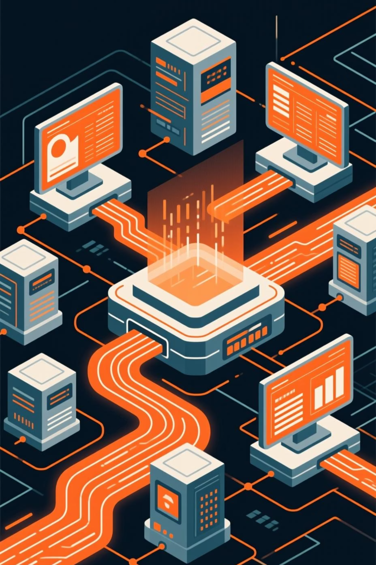
Same: Unified Data Integration
Same provides a powerful platform for seamlessly integrating data from various sources, transforming it, and making it accessible for analysis and applications. It simplifies complex data pipelines and ensures data consistency across your ecosystem. same.io
Steps to Use:
Practical Example:
Connect to diverse data sources (databases, APIs, files).
Consolidate customer data from your CRM, e-commerce platform, and marketing automation tools into a single, unified view. This enables richer customer insights and more personalized engagement strategies.
Define data transformations and cleansing rules.
Set up automated workflows for data synchronization.
Monitor data flow and ensure quality.

Slide 13
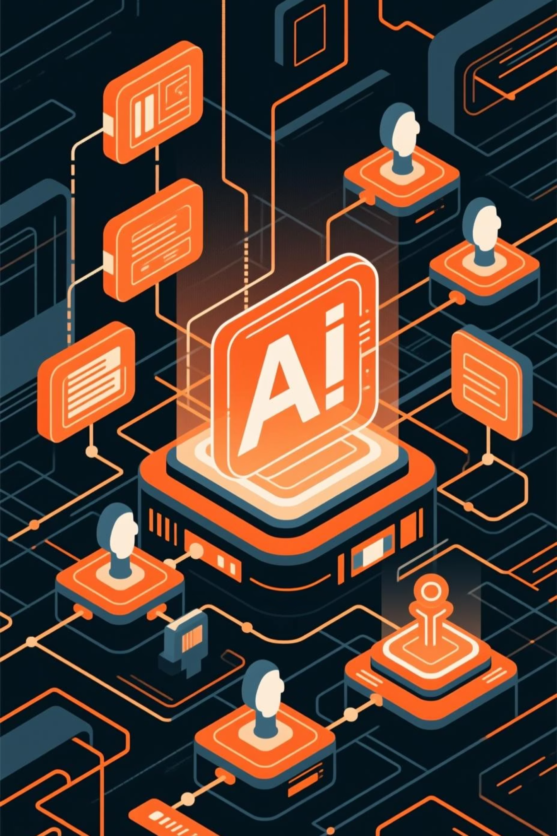
Jules: AI-Powered Workflow Automation
Jules is an advanced AI platform designed to streamline and automate complex business processes. It integrates seamlessly with existing tools, providing intelligent insights and predictive analysis to optimize workflows, reduce manual effort, and improve operational efficiency.
Steps to Use:
Practical Example:
Map out your current workflow processes.
Automate your invoice processing and approval workflow. Jules can extract data from invoices, match them to purchase orders, route for approval based on predefined rules, and automatically update your accounting system, minimizing errors and speeding up payment cycles.
Connect Jules to your core business applications.
Use the visual builder to design and configure automation rules.
Monitor performance and receive AI-driven recommendations for optimization.

